Slide 1
OneParking Activity Modeling Training 02: Essentials
Kiran Mukkamala (XC-DX/EPF3)
2023-05-10

Slide 2
01
Starting Point

Slide 3
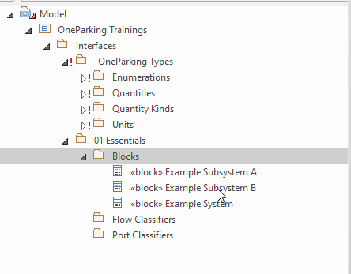
Basic Model Structure
Starting Point
File:
02_Activities_Training_Essentials_Step_01.qea

Slide 4
02
Create Activity With An Activity Diagram

Slide 5
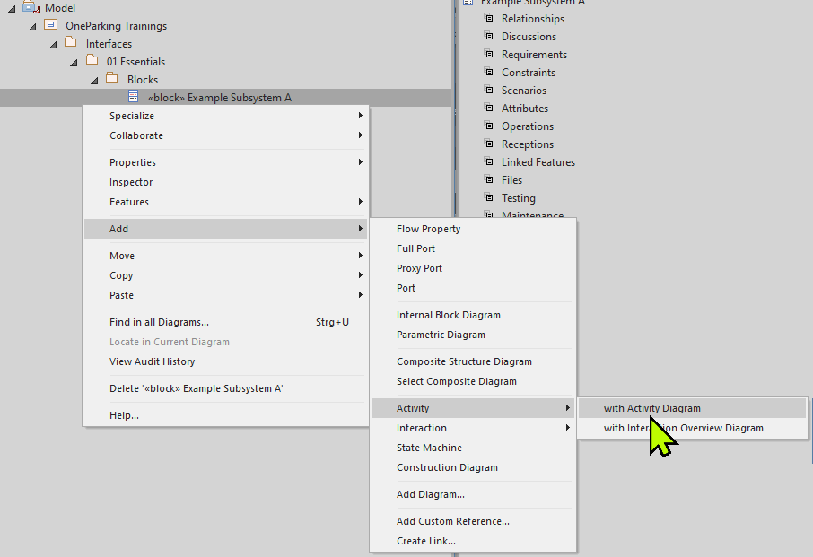
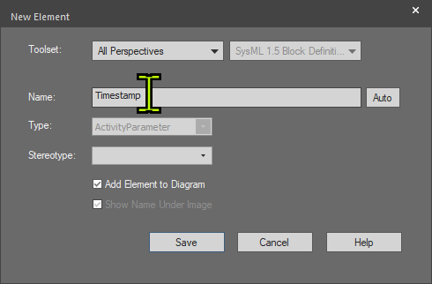
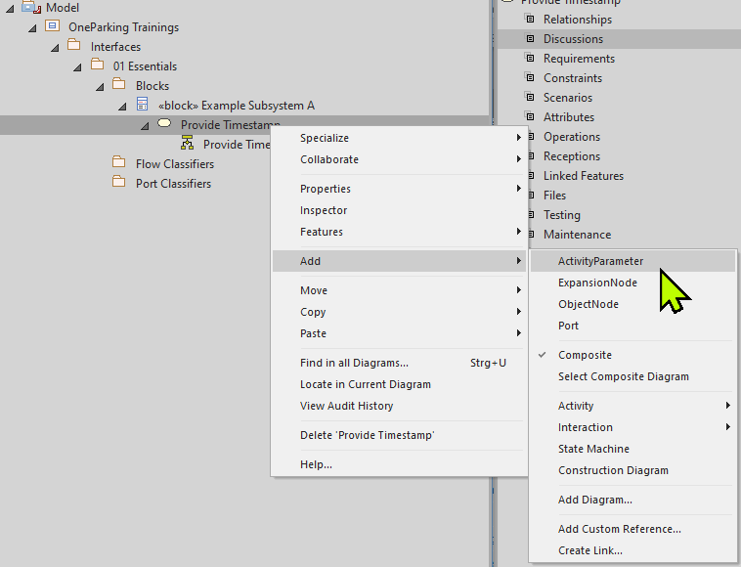
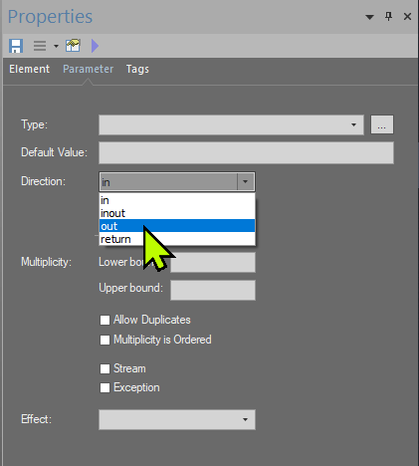
02 (Provide Timestamp)-Part1
Create Activity With An Activity Diagram
Right click by selecting Block (Example Subsystem A), click on Add → Activity → with Activity Diagram and then name the activity as Provide Timestamp (01)
Right click by selecting Activity (Provide Timestamp), click on Add → ActivityParameter (02)
Name the activity parameter as Timestamp, check Add Element to Diagram option and click on Save (03)
Go to Properties of Timestamp activity parameter and under Parameter tab select appropriate direction(out) and click save symbol( ) (04)
01
03
04
02

Slide 6
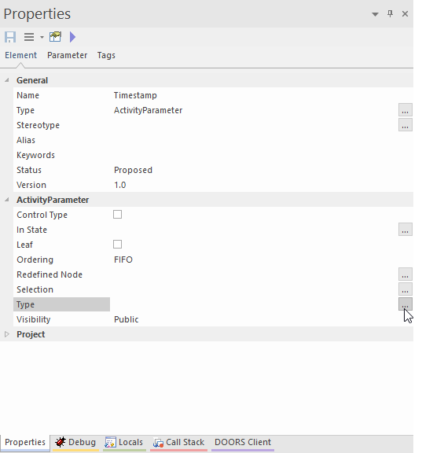
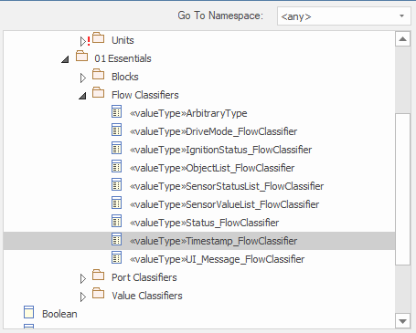
02 (Provide Timestamp)- Part 2
Create Activity With An Activity Diagram
05
Goto Properties of Timestamp activity parameter and select (…) in Type (05)
Navigate in Type selection window and select appropriate type(Timestamp_FlowClassifier) for the activity parameter (Timestamp), click OK (06)
06

Slide 7
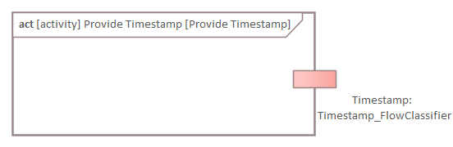
Result after Step 02
Create Activity With An Activity Diagram
02_Activities_Training_Essentials_Step_02.qea

Slide 8
03
Activity Diagram With Connections

Slide 9
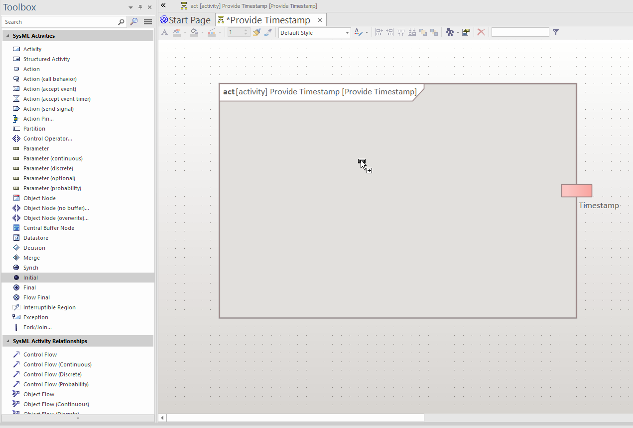
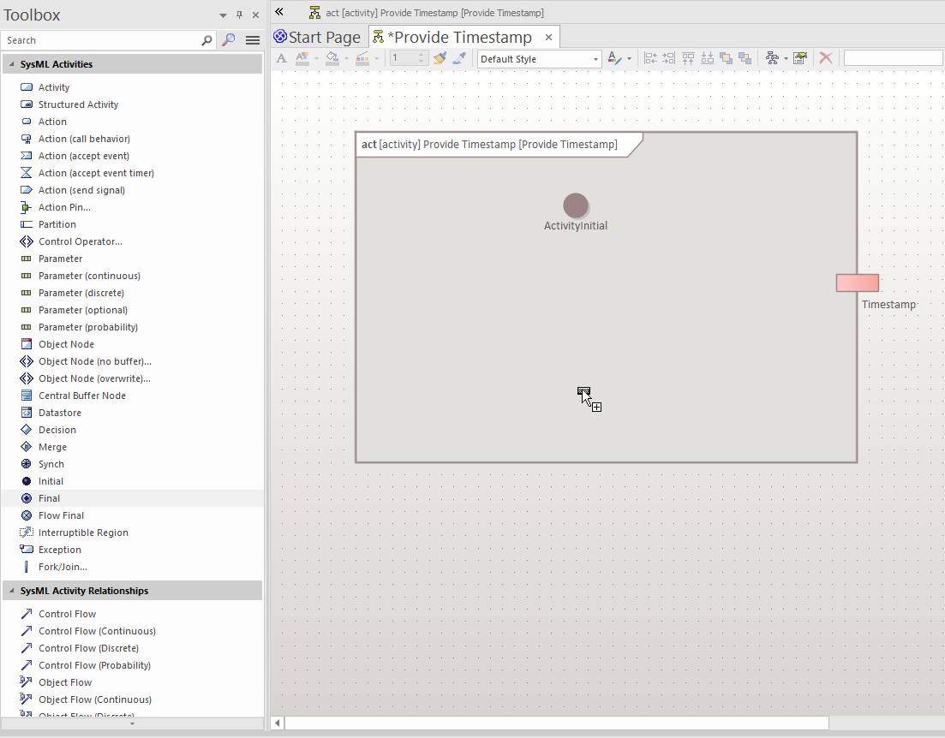
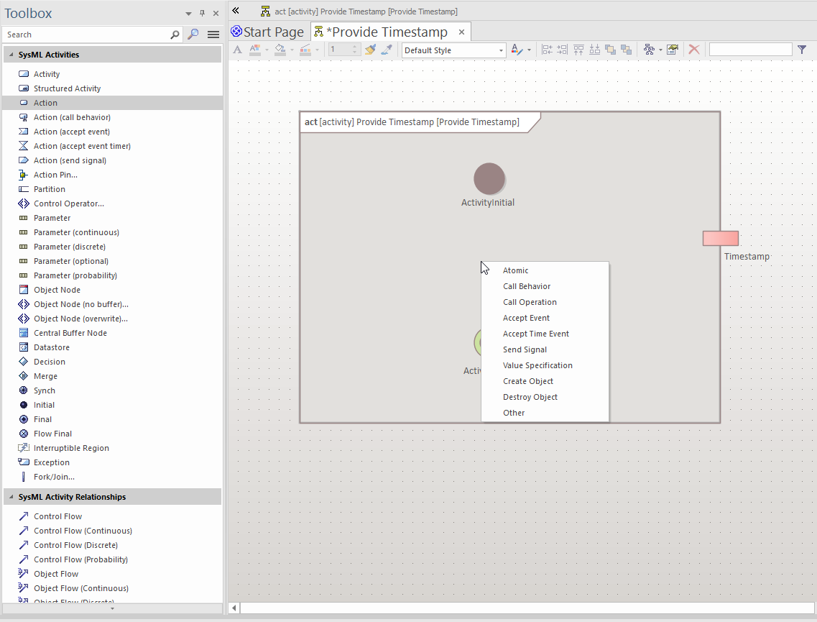
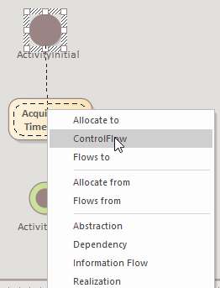
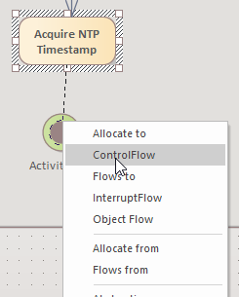
03
Activity Diagram With Connections
Add Activity Initial node to the Activity Diagram (01)
Add an action(select Atomic) to the Activity Diagram, rename it to Acquire NTP Timestamp (02)
Add Activity Final node to the Activity Diagram (03)
Connect Activity Initial node to the Acquire NTP Timestamp by clicking the upward arrow, hold and drag it to desired action(Acquire NTP Timestamp) or any other node. Select Control Flow as connector type (04)
Follow the same between other elements of the activity diagram
01
03
02
04

Slide 10
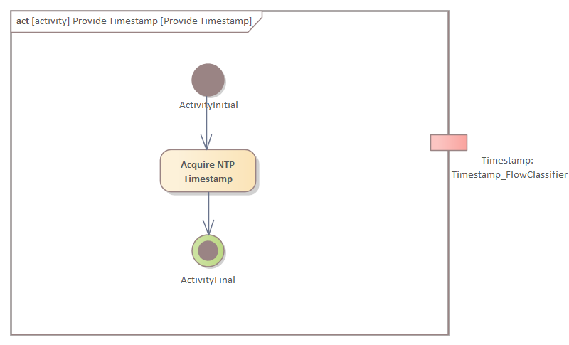
Result after Step 03
Activity Diagram With Connections
02_Activities_Training_Essentials_Step_03.qea

Slide 11
A
Exercise

Slide 12
Statement
Exercise A
Add new activity with diagram named ‘Provide Function Status’ to block Example Subsystem A
Add below Activity parameters with classifiers and direction:
Inputs
Value : SensorValueList_FlowClassifier
Status : SensorStatusList_FlowClassifier
Output
Function Status : Status_FlowClassifier
Add Initial, Final nodes followed by an Action named ‘Function Status’ to Provide Function Status activity diagram and connect these nodes as below: Inital → Function Status → Final
Solution is in the next slide along with EA file

Slide 13
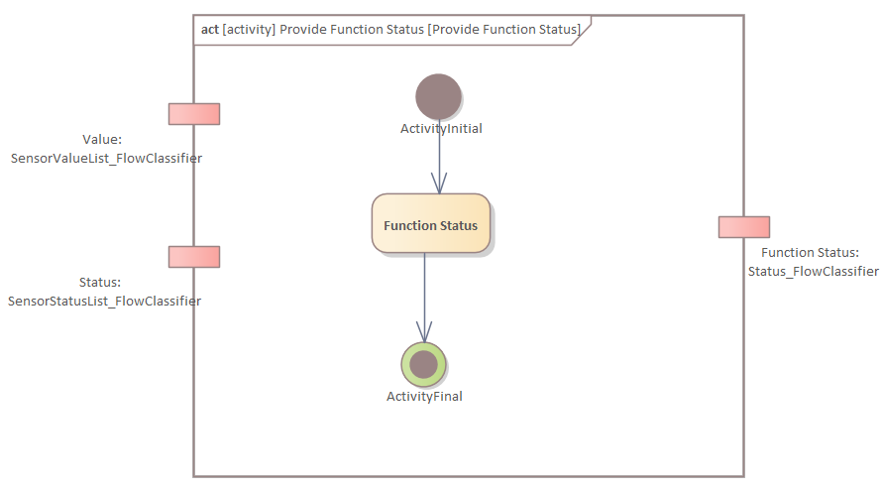
Solution
Exercise A
02_Activities_Training_Essentials_Exercise_A.qea

Slide 14
04
Adding Activity Partition

Slide 15
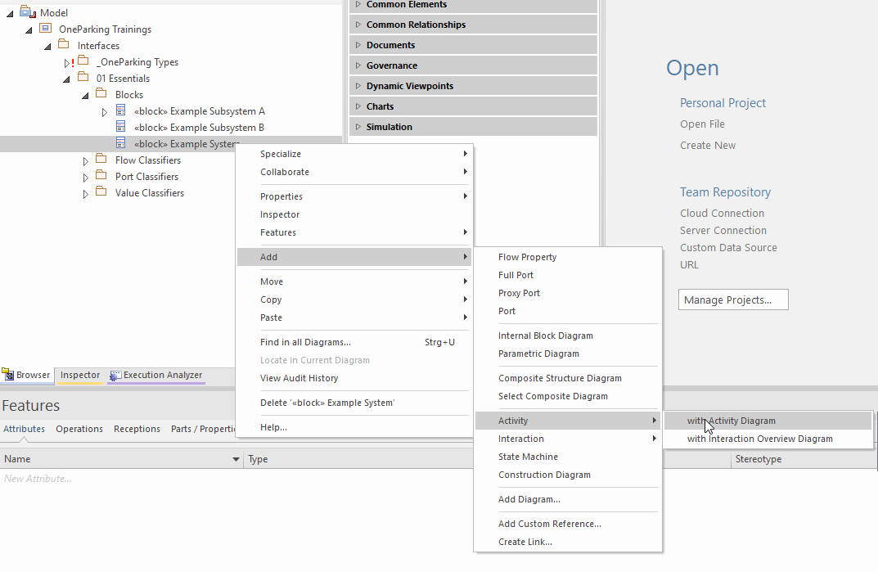
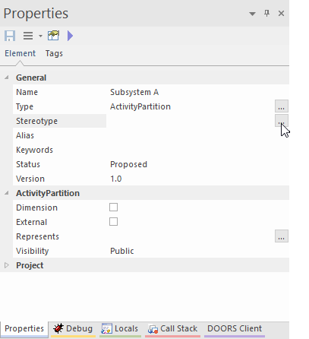
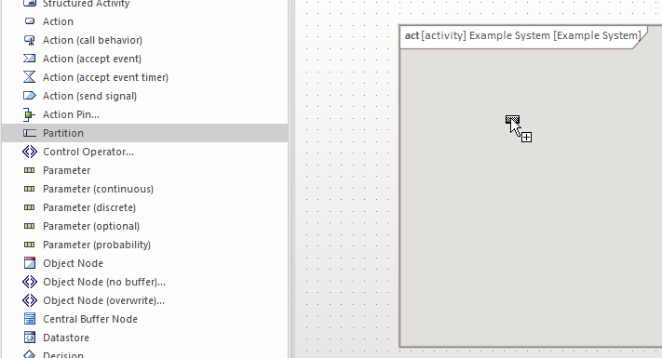
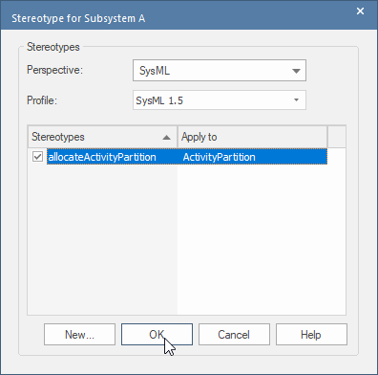
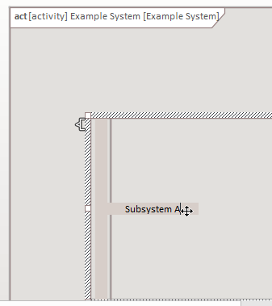
04 (Part 1)
Adding Activity Partition
01
04
Let’s add new activity with diagram called ‘Example System’ (01)
Click on Partition icon in toolbox, drag and drop it to the desired location of activity diagram (02)
Rename the activity partition to desired name(SubSystem A) (03)
Click on (…) Stereotype in properties window of activity partition, select allocateActivityPartition and click OK (04)
02
03

Slide 16
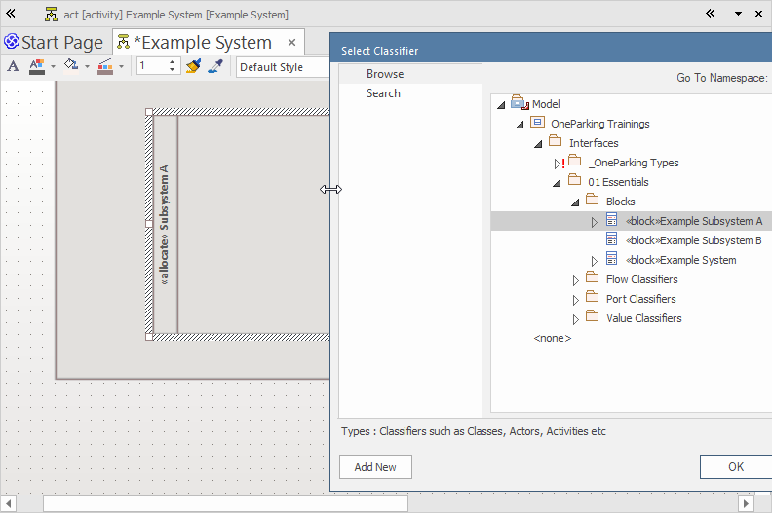
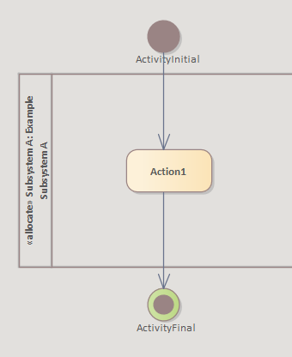
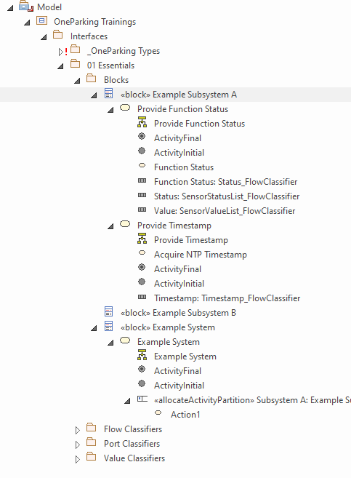
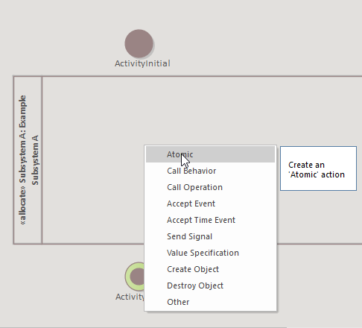
04 (Part 2)
Adding Activity Partition
Let’s associate Activity Partition with a subsystem/ system (05)
Select Activity Partition, press strg + L to get Select Classifier window. Navigate and select the desired subsystem block (Example Subsystem A) (06)
Add Activity Initial, Activity Final node to the Activity Diagram followed by an action(atomic), named Action1 to the activity partition (07)
Connect Activity Initial node to the Action1 by clicking the upward arrow, hold and drag it to desired action(Action1) or any other node. Select Control Flow as connector type (08)
Now Basic Activity Diagram is ready!!!
05
07
08
06

Slide 17
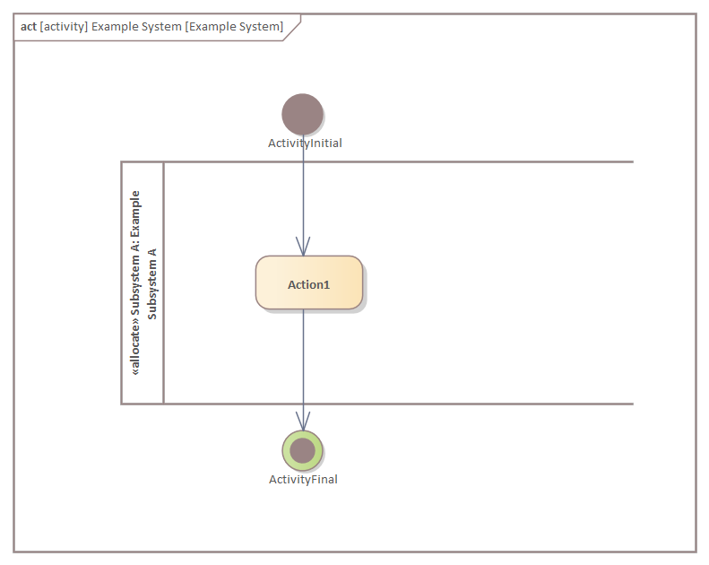
Result after Step 04
Adding Activity Partition
02_Activities_Training_Essentials_Step_04.qea

Slide 18
05
Adding SubSystem Activity

Slide 19
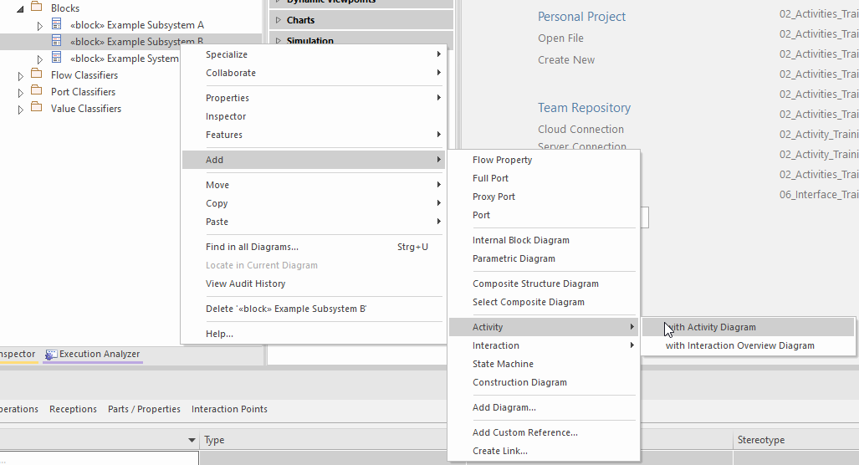
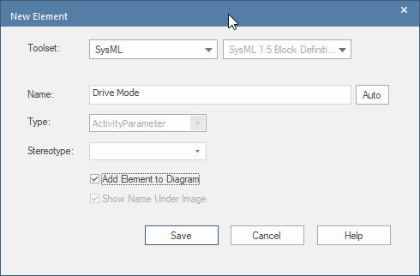
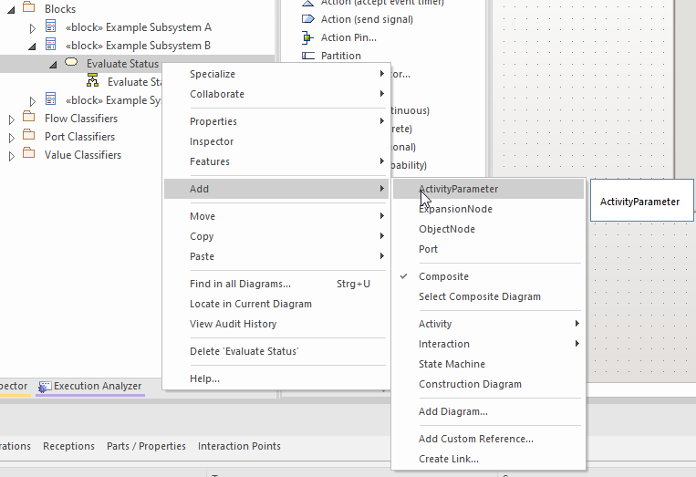
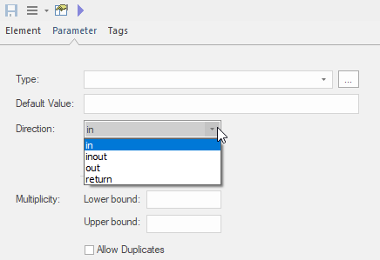
05 (Evaluate Status)
Adding SubSystem Activity
Add an Activity with Activity Diagram to Example Subsystem B, Name the activity as Evaluate Status (01)
Add below Activity parameters along with classifiers and direction: (02, 03, 04)
Inputs
Drive Mode : DriveMode_FlowClassifier
Function Status : Status_FlowClassifier
Output
UI Text: String
01
03
02
04

Slide 20
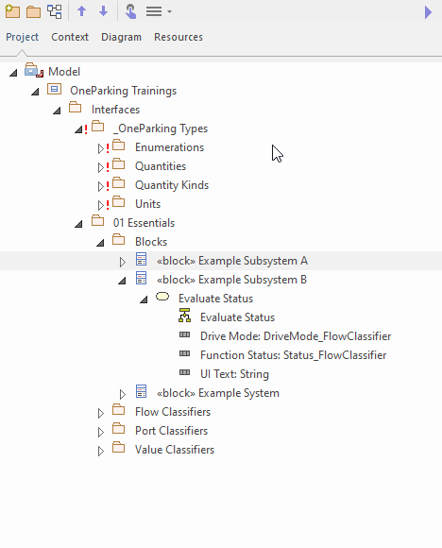
Result after Step 05
Adding SubSystem Activity
02_Activities_Training_Essentials_Step_05.qea

Slide 21
B
Exercise

Slide 22
Statement
Exercise B
Add new activity partition to Example System activity diagram and name as ‘Subsystem B’
Add an Action(atomic) to activity partition Subsystem A and name as ‘Action 2’
Add an Action(atomic) to activity partition Subsystem B and name as ‘Action 3’
Add below Activity Parameters to Example System:
Inputs
Value : SensorValueList_FlowClassifier
Status : SensorStatusList_FlowClassifier
Drive Mode : DriveMode_FlowClassifier
Output
UI Text : String
Time Stamp : Timestamp_FlowClassifier
Note: In order activity parameters to appear in activity diagram, go to Features → Interaction Points check all activity parameters. Always arrange Inputs on left side, Outputs on Right side of the activity diagram for good readability.
Solution is in the next slide along with EA file

Slide 23
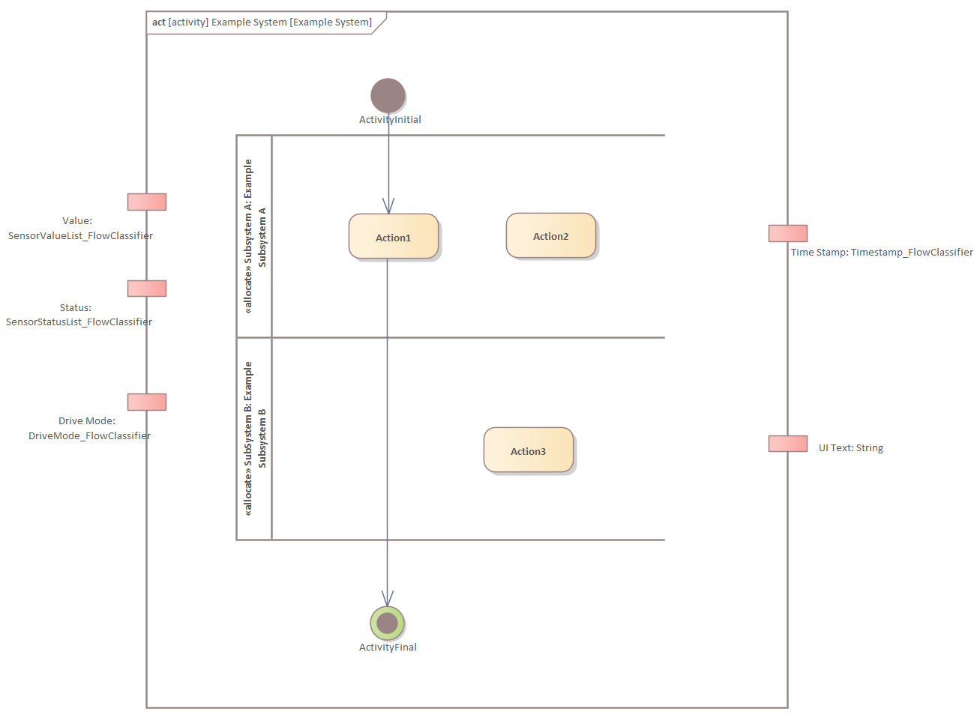
Solution
Exercise B
02_Activities_Training_Essentials_Exercise_B.qea

Slide 24
06
Adding Call behavior to atomic Action

Slide 25
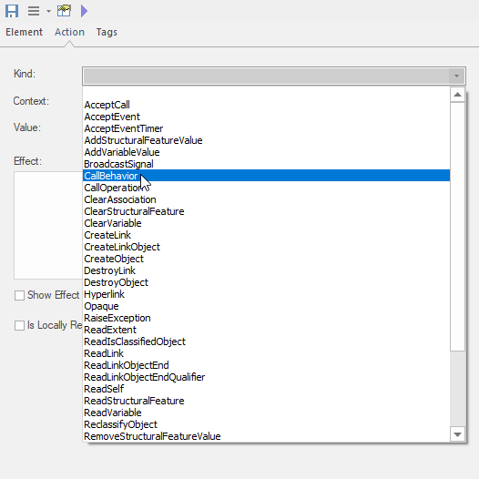
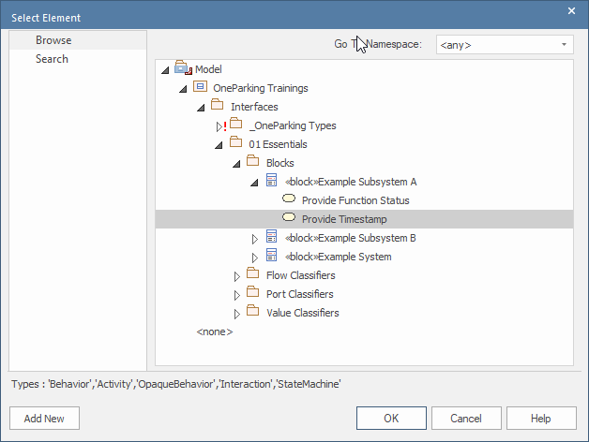
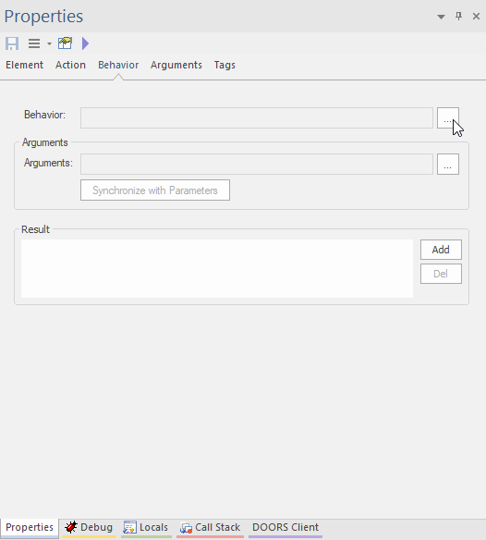
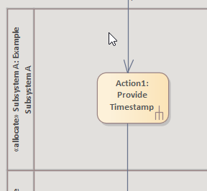
06
Adding Call behavior to atomic Action
01
03
Goto Properties of Action1 and Kind in Action tab, Select CallBehavior and click on Save button in properties window (01)
Now navigate to Behavior tab in Properties window, click on (…) in Behavior option (02)
Now navigate to approproate Activity (Provide Timestamp) and select it then click OK (03)
Now notice a downward fork symbol appears for Action1 (04)
02
04

Slide 26
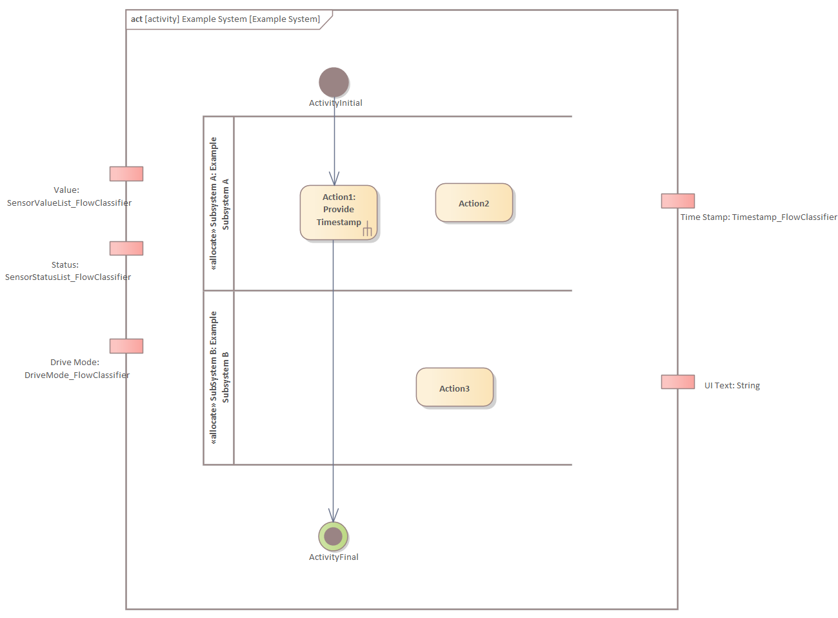
Result after Step 06
Adding Call behavior to atomic Action
02_Activities_Training_Essentials_Step_06.qea

Slide 27
07
Adding Action Pins from Activity Parameters

Slide 28
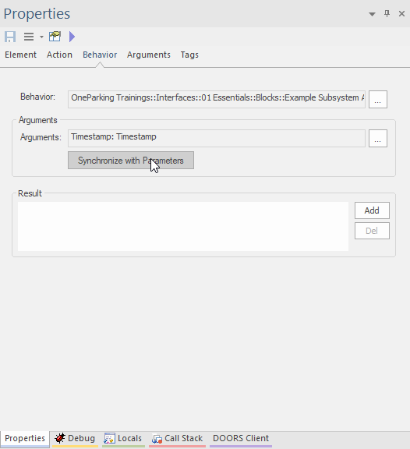
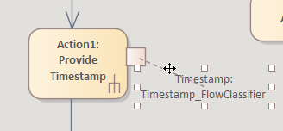
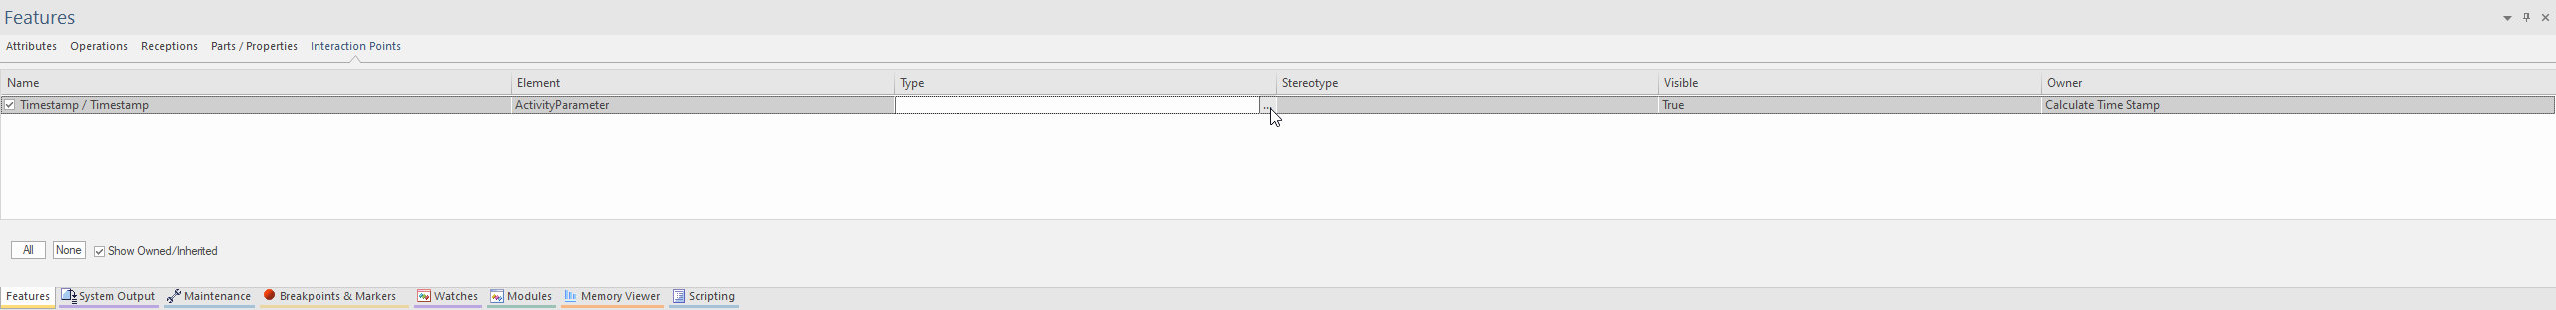
06 Part 1
Adding Action Pins from Activity Parameters
Go to Properties of Action1 and in Behavior tab, Select Synchronize with Parameters (01)
Now an action pin appears on Action1 in activity diagram (02)
Navigate to Interaction Points tab in Features window of Action1, select Timestamp Activity parameter, click on (…) in Type column (03)
01
02
03

Slide 29
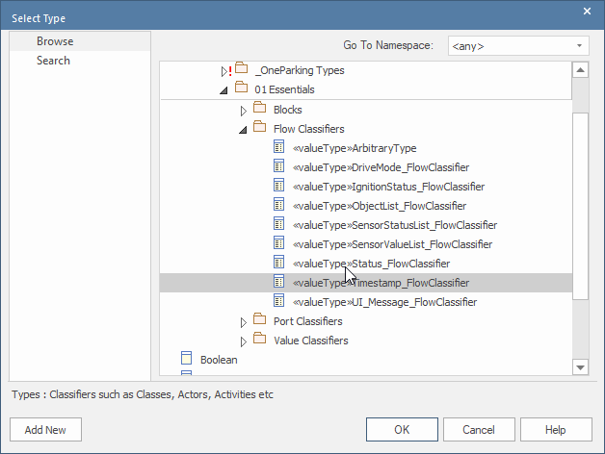
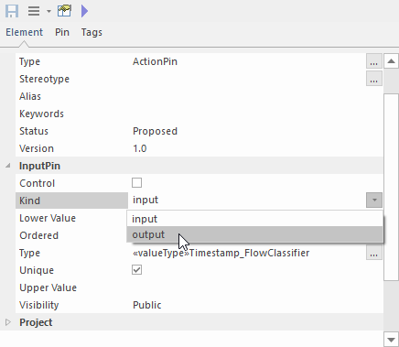
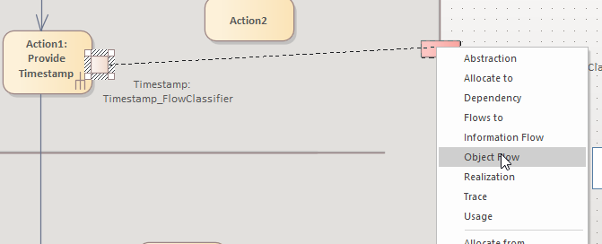
06 Part 2
Adding Action Pins from Activity Parameters
Now navigate to approproate Value Type (Timestamp_FlowClassifier) and select it then click OK (04)
Change the Input Kind as Output (05)
Connect Action Pin to the Activity Parameter by clicking the upward arrow, hold and drag it to activity parameter, Select Object Flow as connector type (06)
04
05
06

Slide 30
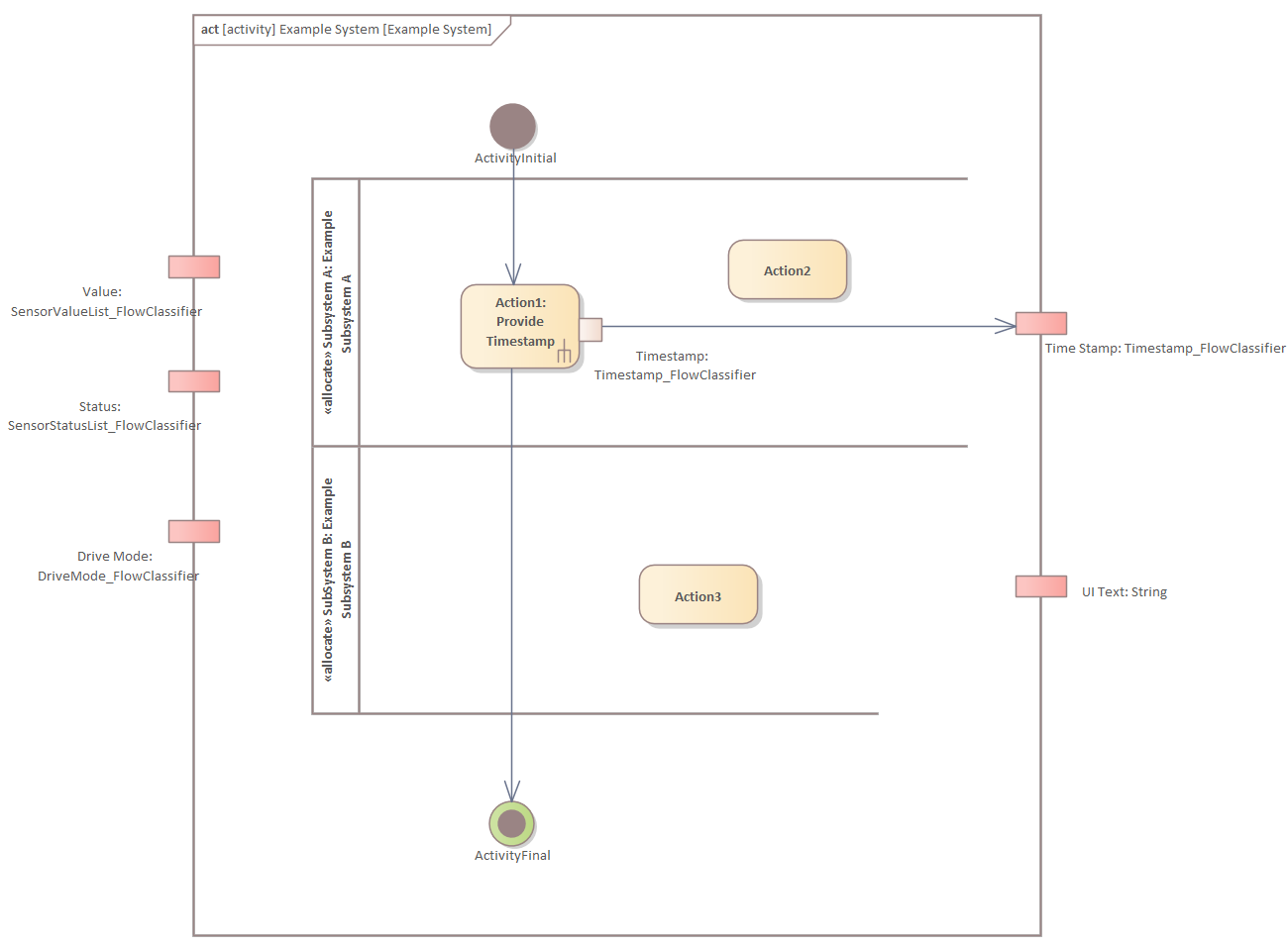
Result after Step 06
Adding Action Pins from Activity Parameters
02_Activities_Training_Essentials_Step_07.qea

Slide 31
C
Exercise

Slide 32
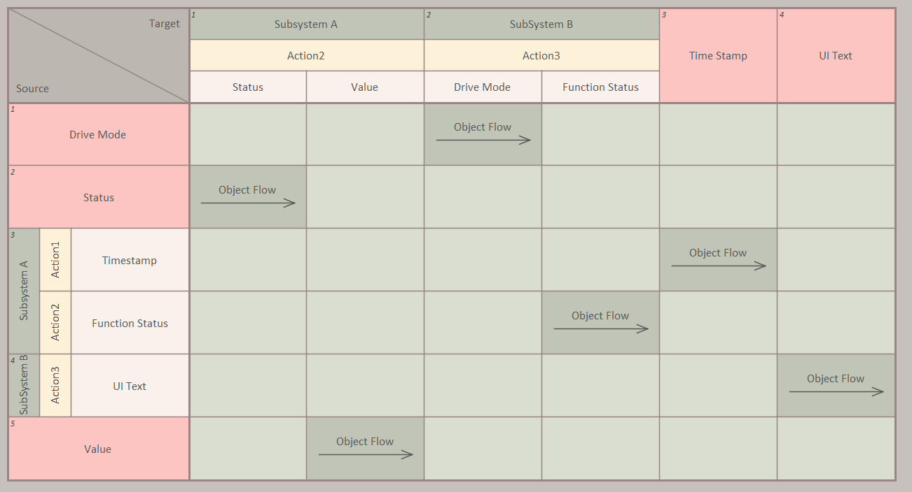
Statement
Exercise C
Add a call behavior to atomic action ‘Action 2’ to activity Provide Function Status in block Subsystem A
Add a call behavior to atomic action ‘Action 3’ to activity Evaluate Status in block Subsystem B
Add(synchronize) activity parameters of each activity to action pins of actions added above
Update the direction and type info as per activity parameter for above action pins
Connect activity parameter and action pins added above according to below table:
Solution is in the next slide along with EA file

Slide 33
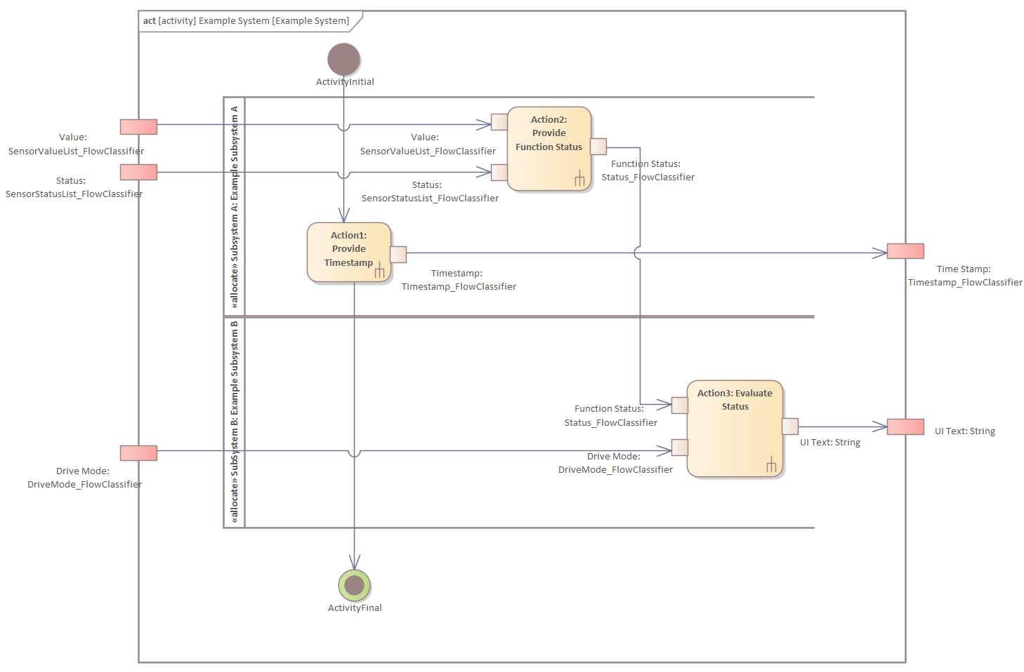
Solution
Exercise C
02_Activities_Training_Essentials_Exercise_C.qea

Slide 34
08
Adding call operation to atomic action

Slide 35
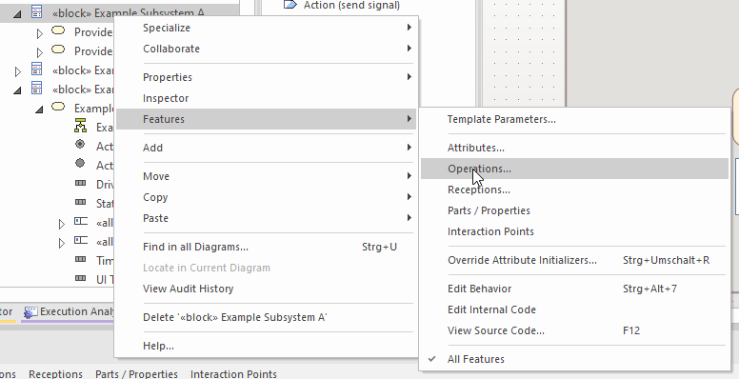
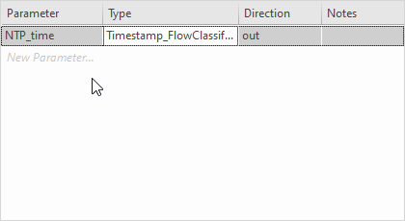
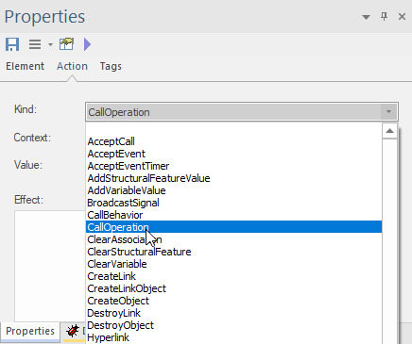
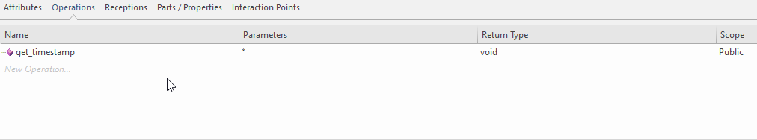
08 Part 1
Adding call operation to atomic action
We can use calloperation in place of call behavior where a simple call operation can be added instead of activity(may need further expansion)
Let‘s add call operation to block Example Subsystem A (01)
Name the operation as get_timestamp (02)
Add One Parameter as NTP_time(out) and type as Timestamp_FlowClassifier (03)
Goto Properties of Acquire NTP Timestamp and Kind in Action tab, Select CallOperation and click on Save button in properties window (04)
01
03
02
04

Slide 36
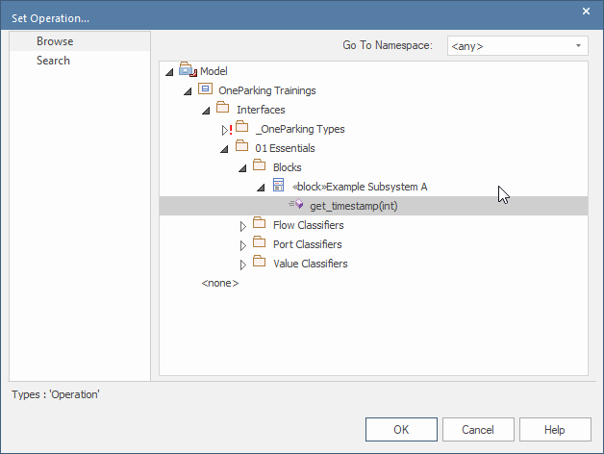



08 Part 2
Adding call operation to atomic action
Navigate to Behavior tab in Properties window, click on (…) in Behavior option and navigate to approproate operation (get_timestamp) and select it then click OK (05)
Go to Properties of Acquire NTP Timestamp and in Behavior tab, Select Synchronize with Parameters (06)
Now an action pin appears on Acquire NTP Timestamp in activity diagram (07)
Navigate to Interaction Points tab in Features window of Acquire NTP Timestamp, select NTP_time action pin, click on (…) in Type column, approproate Value Type (Timestamp_FlowClassifier) and select it then click OK (08)
05
07
06
08

Slide 37


08 Part 3
Adding call operation to atomic action
09
Change the Input Kind as Output (09)
Connect Action Pin to the Activity Parameter by clicking the upward arrow, hold and drag it to activity parameter, Select Object Flow as connector type (10)
10

Slide 38

Result after Step 08
Adding call operation to atomic Action
02_Activities_Training_Essentials_Step_08.qea

Slide 39
09
More Features to come…

